Slide 1



Slide 2







●
●
●
●
●
●
●
●

Slide 3


Slide 4



●
●
●
●

Slide 5


Slide 6
















●
○
●
○
●
○

Slide 7
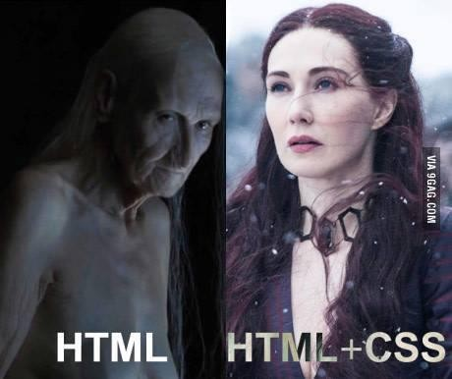

Slide 8
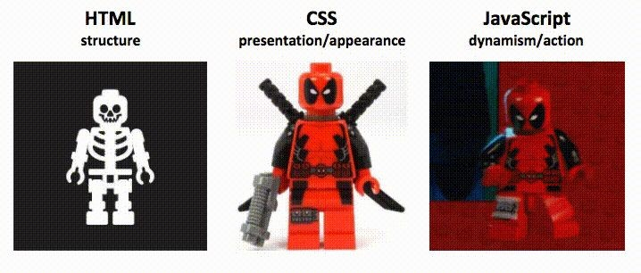
https://d2v4zi8pl64nxt.cloudfront.net/javascript-seo/5948abfc0e2df5.02876591.gif

Slide 9







●
○
○

Slide 10









●
○
○
●
○
○
●
○
○

Slide 11






●
○
■
●
○
○

Slide 12


Slide 13


●
●
○
○

Slide 14
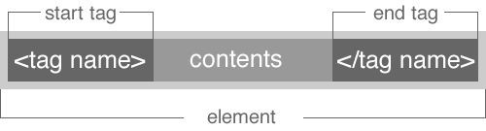





●
●
○
○
○
○
●
<p>This is a paragraph</p>

Slide 15
●
Some HTML elements do not have a closing tag
●
Sometimes called “Singleton Elements”
●
These elements do not accept text
●
<br />

Slide 16

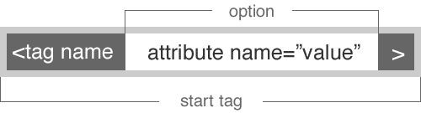





●
●
○
○
○
■
●
<img src=“logo.jpg” alt=“logo” />

Slide 17




<p>This is a paragraph about <strong>HTML</strong></p>
●
●
○
○
<img src=“logo.jpg” />

Slide 19
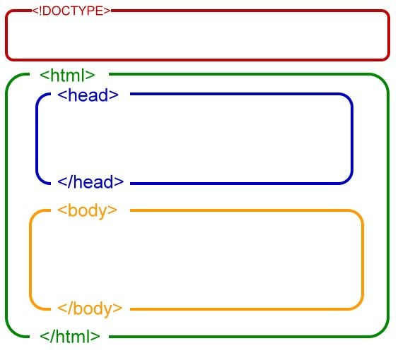
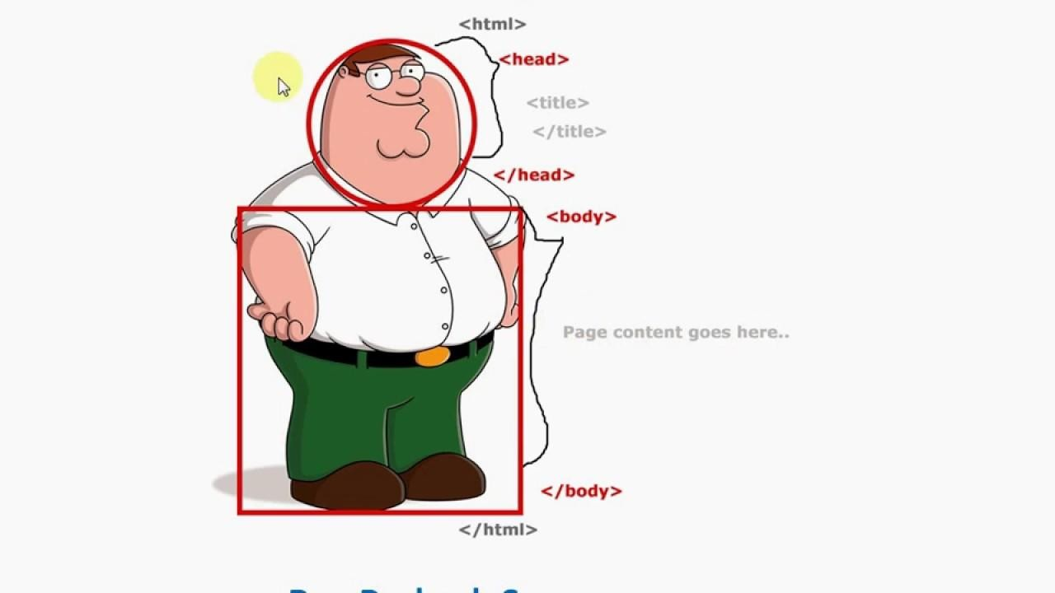

Slide 20

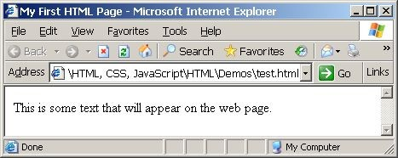

<!DOCTYPE html>
<html lang="en">
<head>
<title>My First HTML Page</title>
</head>
<body>
<p>This is some text that will appear on the web page.</p>
</body>
</html>

Slide 21



<!DOCTYPE>
●
○
○
<!DOCTYPE html PUBLIC "-//W3C//DTD XHTML 1.0
Transitional//EN"
"http://www.w3.org/TR/xhtml1/DTD/xhtml1-transitional.dtd">
○
<!DOCTYPE html>

Slide 22

<html>
●
●
<html></html>

Slide 23





<head>
●
●
○
○
○
○
Load Fonts and CSS files in the <head>!
<title>My First HTML Page</title>
<meta charset="utf-8" />
<meta name="description" content="HTML page that was created by me"/>
<meta name="keywords" content="html, first" />
<meta name="author" content="John Smith" />
<link rel="shortcut icon" href="favicon.ico" type="image/x-icon">
<link rel="stylesheet" href="my-css-file.css">

Slide 24





<body>
●
○
○
○
○
○
○
Load JavaScript files right before closing the <body> tag!

Slide 25

How The Web Browsers
Work
27

Slide 26
How The Web Browsers Work
1. Get HTML
2. Parse head
Make requests to get the referenced files in the order of their
appearance
○ => place .css and font files first
3. Parse body
○ Create DOM and CSSOM, merge them and render the page
○ Make requests to get the referenced files
○ => for most use cases, place .js files as the last tags in the body
28*

Slide 27


Slide 28




●
○
○
●
○
○
○
Display Type
Display Type

Slide 29




●
○
○
<div>
<p>This is a paragraph.</p>
<p>This is a second paragraph.</p>
</div>
●
○
○
<p>This is an <span style=“color:red”>important</span> paragraph.</p>

Slide 30

●
○
○
○
●
<!-- some code here -->

Slide 31


●
<p>This is a paragraph.</p>
●
<h1>This is a title.</h1>
○
○

Slide 32













●
<ol type="1">
<li>Apple</li>
<li>Orange</li>
<li>Pear</li>
</ol>
●

Slide 33









●
<ul type="disc">
<li>Apple</li>
<li>Orange</li>
<li>Pear</li>
</ul>
●
●
●
●
○
○
○
■
■
■

Slide 34


●
○
<dt> <dd>
<dl>
<dt>HTML</dt>
<dd>A markup language …</dd>
<dt>CSS</dt>
<dd>Language used to …</dd>
</dl>
●
●

Slide 35
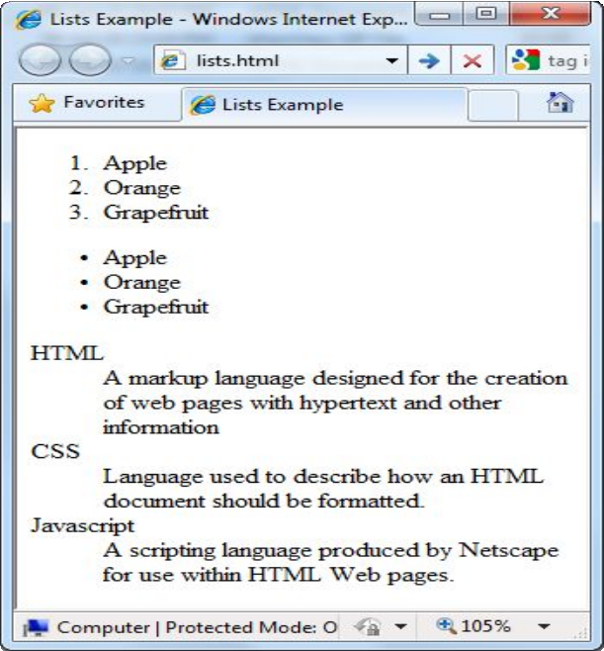
<ol type="1">
<li>Apple</li>
<li>Orange</li>
<li>Grapefruit</li>
</ol>
<ul type="disc">
<li>Apple</li>
<li>Orange</li>
<li>Grapefruit</li>
</ul>
<dl>
<dt>HTML</dt>
<dd>A markup lang…</dd>
</dl>

Slide 36



<p>I would like to emphasize <em>this</em> word.</p>
●
●
<h1>Do <strong>not</strong> forget about this!</h1>
●
○
○

Slide 37

<a href="form.html">Link to form.html in the same folder</a>
<a href="../parent.html">Link to parent.html in parent folder</a>
<a href="child/file.html">Link to file.html in child subfolder</a>
<a href="http://www.google.com">Link to an external site</a>
<a href="http://www.google.com" title="Google">Link to an external site with additional information</a>
<a href="http://www.google.com" target="_blank">Link to an external site that opens in a new window</a>
<a href="mailto:me@example.com">Link to an email</a>
<a href="mailto:me@example.com?cc=a@ex.com">Email link with cc</a>

Slide 38
<a href="http://www.google.com" target="_blank">Link to an external site that opens in a new window</a>
<a href=”mailto:me@example.com”>Link to an email</a>
<a href=”mailto:me@example.com?subject=Hello from Scoala Informala!”>Another email</a>
<a href=“tel:+40799055393”>Link to an email</a>
Anchor links special actions:
ATTRIBUTE target=“_blank” - Open a page in a new window
The “target” attribute can have other values, rarely used in the present
HREF mailto=“email@address.com”: Open the e-mail client and send an e-mail
HREF tel=“+44123453” : Opens the system dialer and calls a telephone number

Slide 39
<a href="#section1">Go to Introduction</a>
...
<h2 id="section1">Introduction</h2>
<a href="chapter3.html#section3.1.1">Go to Section 3.1.1</a>
<!-- In chapter3.html -->
...
<div id="section3.1.1">
<h3>3.1.1. Technical Background</h3>
</div>
You can also use Anchor links to navigate sections (fragments) of a website

Slide 40




●
●
<img src="images/logo.png">
<img src="images/logo.png" alt="Website Logo">
●
src
alt
height
width
border

Slide 41


Slide 42

●
●
●
●
<form></form>

Slide 43

<input type="text" name="FirstName" value="This is a text field" />
●
●
<textarea name="Comments">This is a multi-line text field</textarea>
●
<input type="hidden" name="Account" value="This is a hidden text field" />
○

Slide 44





●
<label for="first_name">First Name</label>
<input type="text" id="first_name" />
●
●

Slide 45


<input type="checkbox" name="fruit" value="apple" />
●
●
<input type="radio" name="title" value="Mr." />
●
<input type="radio" name="city" value="Cluj" />
<input type="radio" name="city" value="Huedin" />

Slide 46

●
<select name="level">
<option value="1" selected>Beginner</option>
<option value="2">Intermediate</option>
<option value="3">Advanced</option>
</select>

Slide 47

●
<select name="products" multiple>
<option value="1">keyboard</option>
<option value="2">mouse</option>
<option value="3" selected>speakers</option>
<option value="4" selected>monitor</option>
<option value="5">printer</option>
</select>

Slide 48


<input type="password" name="pass" />
●
●
<input type="button" value="click me" />

Slide 49

<input type="reset" name="resetBtn" value="Reset the form" />
●
●
<input type="submit" name="submitBtn" value="Apply Now" />
●
<input type="image" src="submit.gif" name="submitBtn" alt="Submit" />

Slide 50


●
<form>
<fieldset>
<legend>Client Details</legend>
<input type="text" id="Name" />
<input type="text" id="Phone" />
</fieldset>
<fieldset>
<legend>Order Details</legend>
<legend>
<input type="text" id="Quantity" />
<textarea cols="40" rows="10" id="Remarks"></textarea>
</fieldset>
</form>

Slide 51

<form>
<input name="subject" type="hidden" value="Class" />
<fieldset><legend>Academic information</legend>
<label for="degree">Degree</label>
<select name="degree" id="degree">
<option value="BA">Bachelor of Art</option>
<option value="BS">Bachelor of Science</option>
<option value="MBA" selected="selected">Master of Business Administration</option>
</select>
<br />

Slide 52


<label for="studentid">Student ID</label>
<input type="password" name="studentid" />
<label for="classes">Classes Attended</label>
<select multiple name="classes" id="classes">
<option value="1">Geography</option>
<option value="2">Mathematics</option>
<option value="3">English</option>
</select>
</fieldset>

Slide 53
<fieldset><legend>Personal Details</legend>
<label for="fname">First Name</label>
<input type="text" name="fname" id="fname" />
<br />
<label for="lname">Last Name</label>
<input type="text" name="lname" id="lname" />
<br /> Gender:
<input name="gender" type="radio" id="gm" value="m" />
<label for="gm">Male</label>
<input name="gender" type="radio" id="gf" value="f" />
<label for="gf">Female</label>
<br />
<label for="email">Email</label>
<input type="text" name="email" id="email" />
</fieldset>

Slide 54
<p>
<textarea name="terms" cols="30" rows="4" readonly="readonly">TERMS AND CONDITIONS...</textarea>
</p>
<p>
<input type="submit" name="submit" value="Send Form" />
<input type="reset" value="Clear Form" />
</p>
</form>

Slide 55
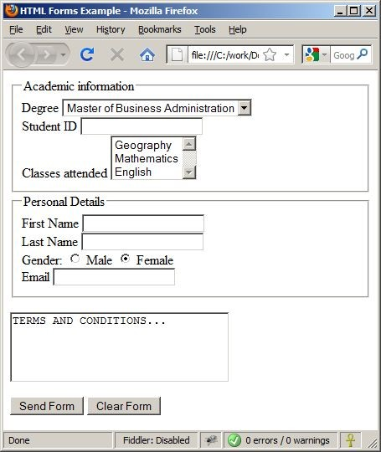



Slide 56
Special HTML Characters
HTML entities
56

Slide 57










 | &copy; | ©
 | &reg; | ®
 | &trade; | ™
 | &lt; | <
 | &gt; | >
 | &amp; | &
 | &nbsp;
 | &mdash; | —
 | &quot; | "
 | &#8364; | €
 | &pound; | £

Slide 58
Exercise
Implement a static HTML page, the first page of your blog. Use your imagination to fill it with content that you like, but be smart and try to provide interesting info about you, what you like to do, what are your hobbies and so on and maybe a picture with you so your colleagues can recognize you.
Add to your blog, a “blog roll” like section and link all your colleagues blogs on that section. (hint: use ul element for that)
Use these tags : <html>, <head>, <title>, <body>, <header>, <footer>, <p>, <img>, <a>, <ul>, <span>
You can use these attributes in your tags: title=, href=, src=, width=, height=, alt=, id=
68

